Slide 1
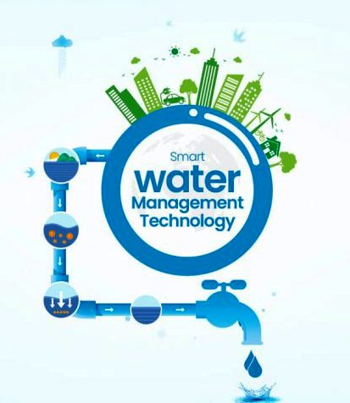
SMART WATER MANAGEMENT
PHASE 1
Problem definition and design thinking

Slide 2
Titles
Project definition
Problem of Water scarcity
Intro to Smart water management
Challenges
Design Thinking
Presentation Title

Slide 3
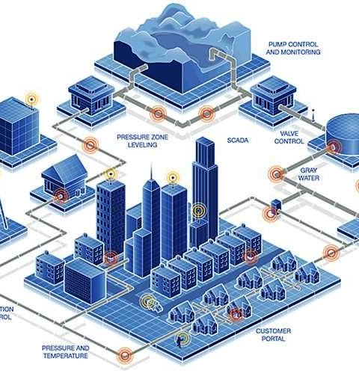
Project Definition
Objective:
The project aims to promote water conservation by implementing IoT sensors for real-time water consumption monitoring in public places.
Key Goals:
Monitor water usage in real-time. Raise public awareness about water conservation. Enable sustainable resource management. Scope: Public places such as parks and gardens.

Slide 4
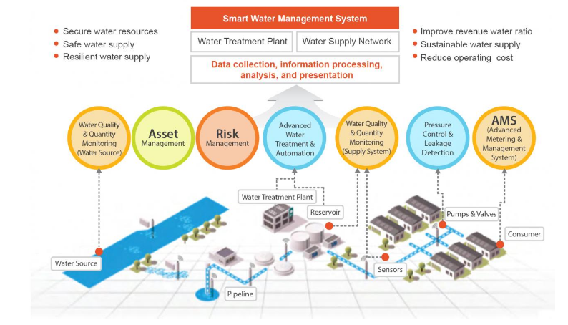
Intro To Smart water Management
Smart water management combines advanced technologies with traditional water management strategies to optimize resource usage and minimize water wastage.
By leveraging IoT, water systems can be monitored and
managed in real-time, enabling proactive decision-making for sustainable water management.
Smart water management relies on sensors and Internet of Things (IoT) devices strategically placed throughout water infrastructure. These sensors collect real-time data on water quality, quantity, pressure, and usage patterns.

Slide 5
Challenges
Meters & Sensors
Flow
Pressure
Quality
SCADA
Consumption
Leak Detction
Despite the benefits, implementing smart water management systems requires overcoming certain challenges.
Common obstacles include high upfront costs, complex data integration, cybersecurity concerns,and resistance to adopting new technologies.
Overcoming these challenges is crucial for successful implementation and long-term sustainability.

Slide 6
Design Thinking
Project Objectives:
Real-time Monitoring: Develop a system to continuously monitor waterconsumption.
Public Awareness: Create a platform to share consumption data with the public.
Water Conservation: Implement alerts and notifications for excessive water use.
Resource Management:Analyze data to identify trends and optimize water usage.

Slide 7
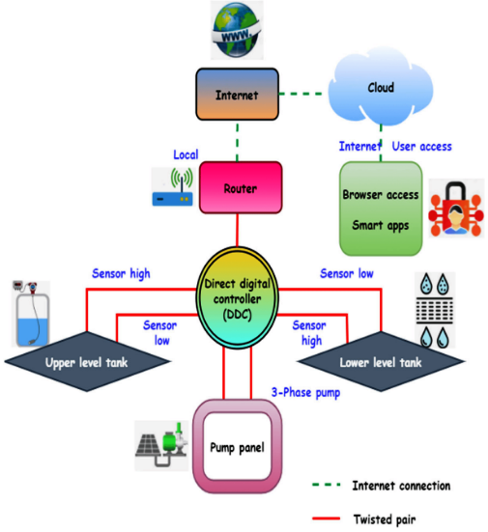
IoT Sensor Design:
Sensor Selection:
Choose appropriate IoT sensors for water consumption measurement.
Deployment Strategy:
Determine sensor placement in public areas.
Data Accuracy:
Ensure sensors provide accurate consumption data.
Power Management:
Plan for sensor power supply and energy-efficient operation.

Slide 8
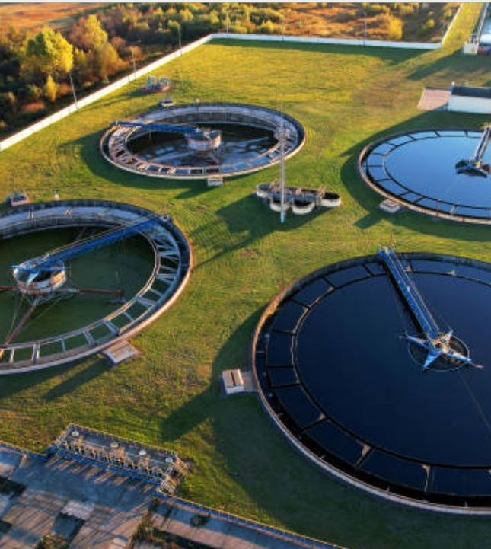
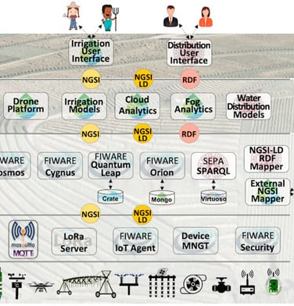
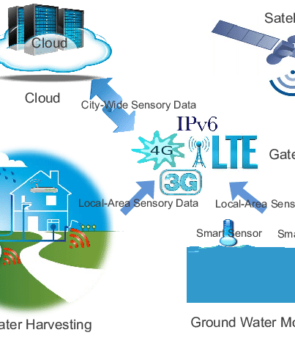
Real-Time Data Platform:
Development:
Create a data-sharing platform for public access.
User Interface:
Design a user-friendly mobile app to display real-time data.
Data Presentation:
Visualize consumption data in a comprehensible manner.
User Engagement:
Include features for user feedback and reporting.

Slide 9
Project Execution Plan
Conduct a thorough site survey to identify suitable locations for sensor deployment.
Procure and install IoT sensors according to the deployment plan.
Develop the mobile app and data-sharing platform with real-time data display and user interaction features.
Implement data transmission and processing mechanisms. Conduct user testing and gather feedback for refinement.
Launch the IoT water consumption monitoring system in public places.
Continuously monitor and maintain the system, addressing any issues promptly

Slide 10
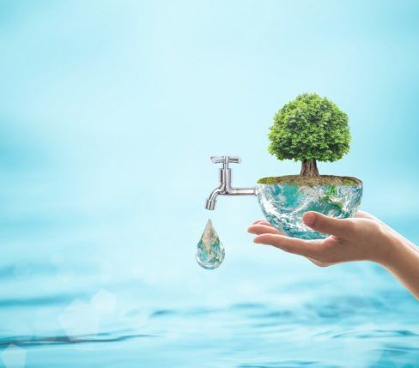
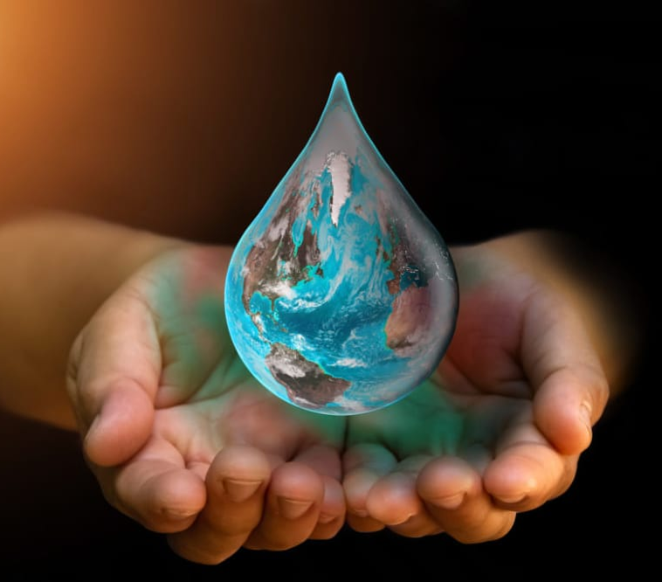
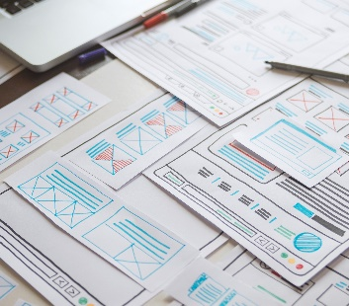
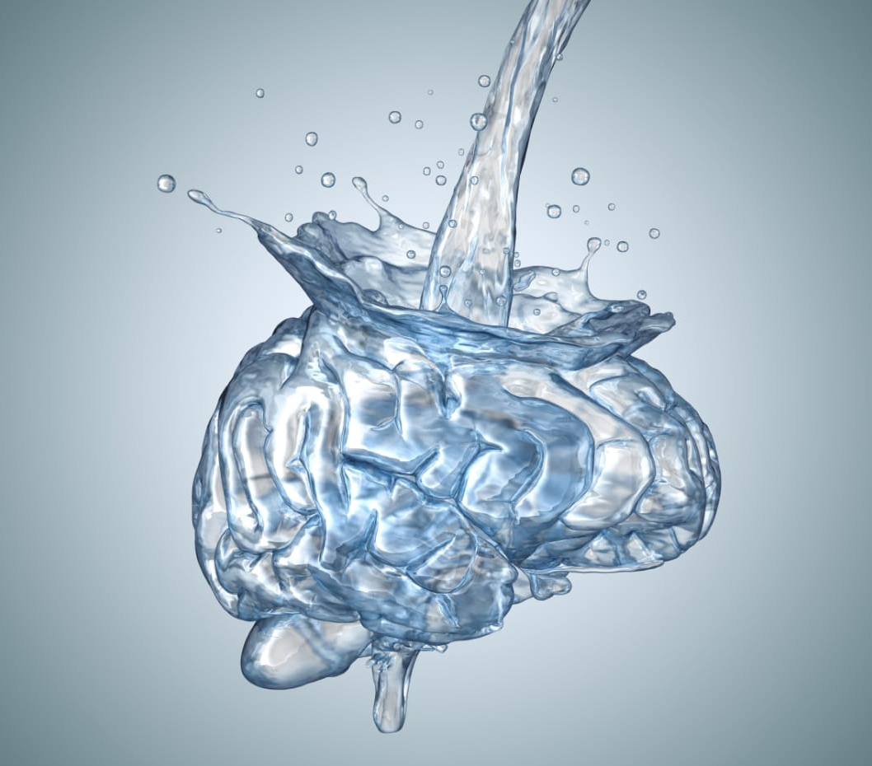
Thank you

